Slide 1
Webpack + ES6 + Typescript

Slide 2
Установка Webpack
Npm init
Npm i –D webpack
Npm i –D cross-env
Npm i –D webpack-dev-server
Npm i –D webpack-cli
Package.json
"scripts": {
"start": "cross-env NODE_ENV=development webpack-dev-server --inline --progress --colors",
"build": "cross-env NODE_ENV=production webpack"
},

Slide 3
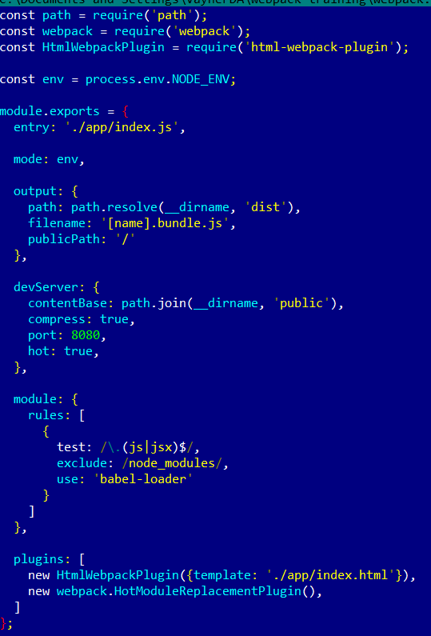
Структура проекта
webpack.config.js
./app/index.html
./app/index.js
./app/index.scss

Slide 4
Установка по следам конфига
npm i -D html-webpack-plugin
npm i -D babel-loader
npm i -D @babel/core

Slide 5
Что имеем?
Транспиляция ES6 -> ES5

Slide 6
TypeScript
resolve: {
extensions: [".tsx", ".ts", ".js"]
},
Rules
{
test: /\.tsx?$/,
loader: 'ts-loader',
exclude: /node_modules/,
},
Npm i –D typescript
Npm i –D ts-loader

Slide 7
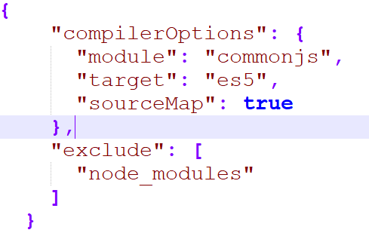
TypeScript
Tsconfig.json

